Slide 1
Data Analytics in Practice
Use Case
Laura Anderson, Data Scientist
Katherine Hutcheson, Graduate Data Scientist

Slide 2
What do we do ?

Slide 3


Categorisation-as-a-Service (CaaS)
Our machine learning categorisation engine
CaaS identifies patterns and signals in a customer’s financial behaviour.
It creates value by giving clients a deeper insight on an individual’s finances, as well as a broader understanding of the behaviour of a portfolio of customers.
It helps clients anticipate risk, improve decision making, and be more responsive to changes in a customer’s personal finances.

Slide 4















“Categorisation as a Service” (CaaS) Our machine learning categorisation engine has processed over 10Bn transactions
Income & expenditure blocks
Insight Packages
180+
Categories
Income
Liquidity metrics
T
A
Essential Spend
Credit
cards
Bank
account
X
O
Basic Quality of Living
Machine
Learning
engine
Income KPIs
AUTOMATION
Deployment of
the decision
N
Committed Expenditure
O
M
Y
Discretionary Spend
Balance characteristics
95%
Accuracy
Standard Financial Statement
Behaviour
CastScore

Slide 5
The motivation

Slide 6
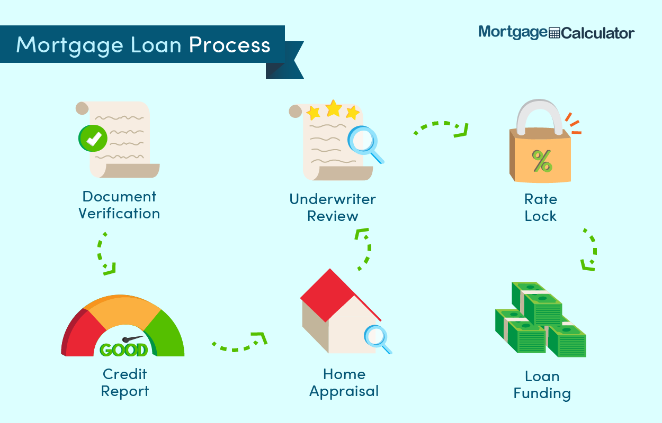
Mortgage Applications
You could see a typical mortgage application process on the left.
How can Experian help?
The first step for lenders is to begin verifying assets, income and employment etc. This could be a time-consuming process, with a time delay and a relatively primitive view of a consumer.
Faster and more Granular Process
Experian’s income verification model calculates applicants' monthly income derived from their bank transactions and aim to speed up the mortgage application process.
The issue is that decisionmakers (lenders) use calculations based on annual gross income which cannot be derived from transactional data (net income). Therefore, we must calculate annual gross income from monthly net income.
Prevent Mortgage Fraud
Buyers provide fraudulent employment details and income values to support their application.
According to Nationwide Building Society 1 in 10 applicants think it’s reasonable to exaggerate their income on a mortgage application
Lenders need to be aware of staged income. Staged income is where applicants create fake income streams regular payments throughout the application process which end after completion.

Slide 7
How could you help ?
Task 1 (50%)
We are asking for you to calculate annual gross income from given monthly net income. The dataset consists of two columns – monthly_net_income and location. Tax systems operate differently in these two regions.
A jupyter notebook will be provided for you to code a means of achieving this, along with a sample of data for you to test your solution. A holdout dataset will be used to evaluate your final solution. The percentage of correct calculations within a margin of error will determine your grade for this task.
Rest of UK
Scotland
N.B. - Follow the format set out in the notebook, as it is an automatic grading system.
- Understand how the tax system works in the UK, strongly advised to write a gross --> net function before net --> gross.
Assume a tax year of 2024/2025 (metrics on following slide)
Assume the only deductions from gross to net are income tax and national insurance (no pension contributions, student loan repayments, etc)
Task 2 (50%)
Have a think about the limitations of your solution (what about pensions, student loan repayments etc), and how these can be addressed (what information can you infer from someone’s bank transactions?) . Also think about how we could identify self-employed workers and location based on transactional data and write a short summary (400 word limit).

Slide 8
What to return
Your source code in the form of a python jupyter notebook environment. No notebook, no grade. We need to understand your code, so please ensure it is well commented understandable variable names, etc.
The salary_holdout.csv with the annual_gross_income field filled.
A pdf or word document for your task 2 solution.
Marking Breakdown
Task 1 (50%):
Result from code (25%)
Explainability of code (10%)
Readability of code (10%)
Demonstration of data exploration (5%)
Task 2 (50%) is dependent on your understanding of the weaknesses of your solution, and how well you have thought out potential solutions.

Slide 9
How the tax system works.
The UK operates on a bracket tax band system. Your rate of tax only applies to the corresponding bracket!
NI and Income Tax are both applied to the gross (pre-tax) salary.
Following numbers based on tax year 2024/2025:
Scottish Income Tax Table
ROU Income Tax Table
Name | Income Bracket | Rate
Personal Allowance | £0 to £12,570 | 0%
Starter Rate | £12,571 to £14,876 | 19%
Basic Rate | £14,877 to £26,561 | 20%
Intermediate Rate | £26,562 to £43,662 | 21%
Higher Rate | £43,663 to £75,000 | 42%
Advanced Rate | 75,001 to 125140 | 45%
Top Rate | > £125,140 | 48%
Name | Income Bracket | Rate
Personal Allowance | £0 to £12,570 | 0%
Basic Rate | £12,571 to £50,270 | 20%
Higher Rate | £50,271 to £125,140 | 40%
Additional Rate | > £125,140 | 45%
Please note: You may notice there is an additional personal allowance taper for non-Scottish residents earning above £100,000. You do not need to consider this personal allowance taper for those in that bracket.
ROU National Insurance Table
Scottish National Insurance Table
Name | Income Bracket | Rate
No payment | £0 to £11,904 | 0%
NI lower | £11,905 to £50,270 | 8%
NI higher | > £50,271 | 2%
Name | Income Bracket | Rate
No payment | £0 to £11,904 | 0%
NI lower | £11,905 to £50,270 | 8%
NI higher | > £50,271 | 2%

Slide 10
Questions ? Email: Katherine.Hutcheson@experian.com

